Slide 1

Data Structures
Week 9 - Doubly Linked Lists
Juan Carlos Pineda
ITESM
juancarlos.pineda@itesm.mx

Slide 2
Introduction
There are different types of linked lists
All can be implemented using similar structs in C

Slide 3
Remember Linked Lists?
A simple linked list is a list of nodes that can be chained to store data.
Data | next
14
Data | next
14
Data | next
14
Data | next
14 | null
Notes:
5 minutes

Slide 4
Structs for Linked Lists
struct node {
int data;
struct node * next;
}

Slide 5
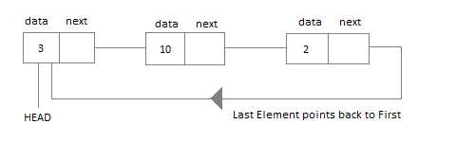
Circular Linked Lists
Circular Linked List is little more complicated linked data structure. In the circular linked list we can insert elements anywhere in the list whereas in the array we cannot insert element anywhere in the list because it is in the contiguous memory

Slide 6
Applications of Circular Linked Lists
The real life application where the circular linked list is used is our Personal Computers, where multiple applications are running. All the running applications are kept in a circular linked list and the OS gives a fixed time slot to all for running. The Operating System keeps on iterating over the linked list until all the applications are completed.
Another example can be Multiplayer games. All the Players are kept in a Circular Linked List and the pointer keeps on moving forward as a player's chance ends.
Circular Linked List can also be used to create Circular Queue. In a Queue we have to keep two pointers, FRONT and REAR in memory all the time, where as in Circular Linked List, only one pointer is required.

Slide 7
Time to code
Modify your existing linear Linked List to be circular
10 min

Slide 8
Doubly-Linked List
A doubly linked list has one extra pointer, pointing to the previous node
It is easier to go over it, but harder to implement since it requires to keep the extra pointer updated
 | Data | next
 | 14
 | Data | next
Prev | 17
 | Data | next
Prev | 4
 | Data | next
Prev | 9

Slide 9
Removing a node
Void remove (int index);
What pointers must be changed to remove a node?
What different cases must we consider?
 | Data | next
 | 14
 | Data | next
Prev | 17
 | Data | next
Prev | 9
 | Data | next
Prev | 4
NULL
NULL

Slide 10
Adding a Node
Void remove (int index);
What pointers must be changed to add a node?
What different cases must we consider?
 | Data | next
 | 14
 | Data | next
Prev | 17
 | Data | next
Prev | 9
 | Data | next
Prev | 4

Slide 11
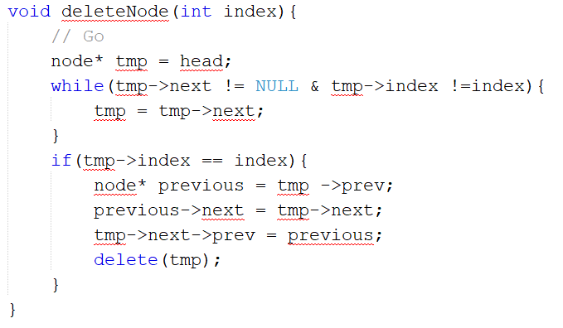
Deleting a node

Slide 12
End of presentation

